Slide 1
AZ-220T01 Module 10: Azure Security Center and IoT security considerations

Slide 2
Lesson 1: Learning objectives

Slide 3
Module 10 – Learning objectives
Describe security concerns and best practices for an IoT solution
Describe the Azure IoT Security Architecture and Threat Modeling
Describe the features and support provided by Azure Defender for IoT
Configure Security Agents and Security Module Twins
Aggregate Azure Defender for IoT Events

Slide 4
Lesson 2: Security fundamentals for IoT solutions

Slide 5
Security recommendations
General:
Stay up to date!
Keep authentication keys safe
Use device SDKs when possible
Identity and Access Management:
Define access control for the hub
Define access control for back-end services
Data protection:
Secure device authentication
Secure device communication
Secure service communication
Notes:
https://docs.microsoft.com/en-us/azure/iot-fundamentals/security-recommendations
(this is slide 1 of 2 covering security recommendations)

Slide 6
Security recommendations
Networking:
Protect physical access to your devices
Build secure hardware
Monitoring:
Monitor unauthorized access to your devices
Monitor your IoT solution from the cloud (overall health)
Set up diagnostics

Slide 7
Security in IoT must be end-to-end
Securely connect million of devices…
…over a secure internet connection…
…to Microsoft Azure – Built with security from the ground up
1010101011010101101000101010101011101000101010101010101010101
10101010110010101101000101010101011101000101010110101011010
Device Security
Device SDKs in multiple languages Any OS | Any HSM including Azure Sphere
Connection Security
X.509/TLS-Based Handshake and Encryption
Cloud Security
IoT Hub | Windows IoT | Azure Sphere Services Azure Trust Center | Azure Compliance Offerings
Notes:
Secure device provisioning and authentication
Devices are outbound-only
Devices can only connect to services that know about them
Authentication and authorization is per-device
Secure connectivity
TLS to the IoT Hub
IoT Hub never opens the device connection
Secure processing and storage in the cloud
Azure Storage services have built-in security mechanisms
Azure Storage is encrypted at rest with managed keys

Slide 8
IoT security best practices for the IoT developer role
Follow secure software development methodology
Choose open-source software with care
Integrate with care
Notes:
The SkillPipe includes information for other roles as well – hardware manufacturer/integrator, solution deployer, and solution operator – but we are focusing on the developer role because that’s the target for the course. There’s some overlap between roles so it makes sense to cover them all in the reference, but not to take class time on it.
Make sure you point out the “choose open-source with care” is not a fear-uncertainty-doubt callout – it’s a callout to make sure there is an active community, active support, etc. for an open source solution.

Slide 9
IoT security architecture and threat modeling
From a security architecture and threat modeling viewpoint, it’s typical for dedicated security staff and/or architects to own that responsibility…
But developers need to be able to participate in the conversations!
Notes:
Again, the SkillPipe gets into detail – a lot of detail for a developer, really – but we want to point out the information is there. If you’d like to expand a bit, and time permits, of course feel free.
We do an example deep dive on the next slide.

Slide 10

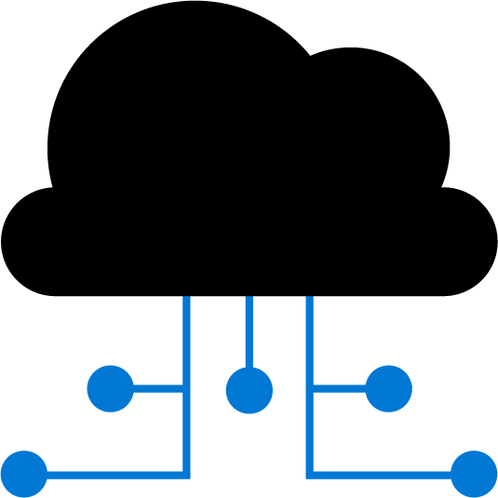
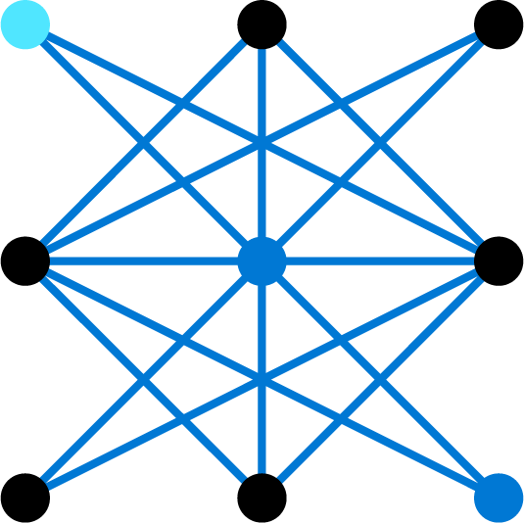


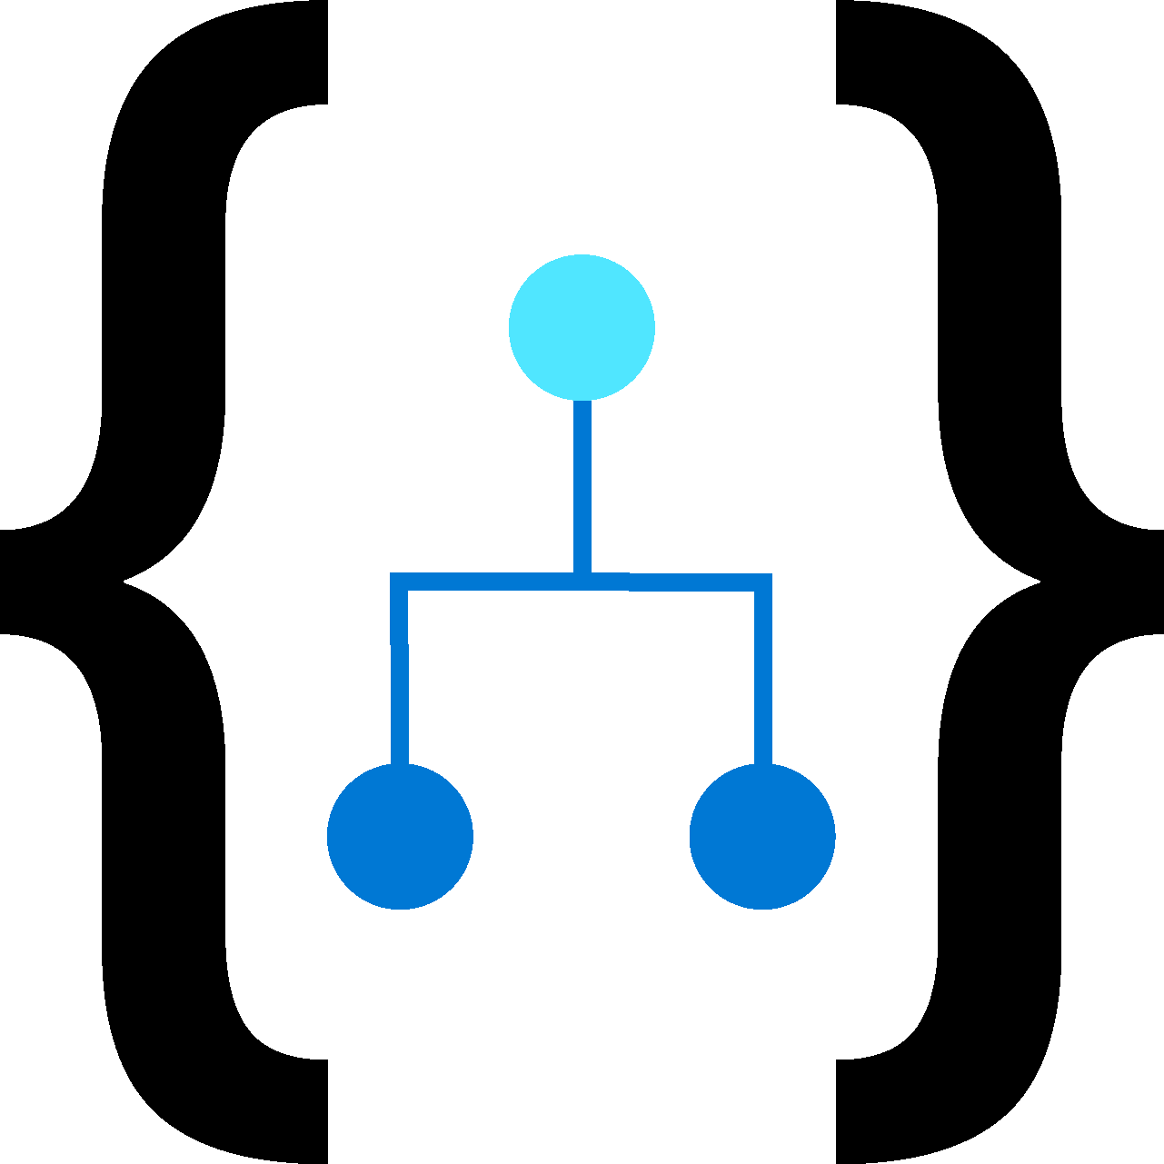
Threat model
Do you trust your devices’ identities and firmware?
How are you sure that device has not been tampered with?
Can someone see your data and possibly tamper with it?
Do you trust the cloud admins?
E2E Security
Predictive Maintenance App
Intelligent
Gateway
Connectivity
Cloud Hub
Service Technician
ERP (Finance)
Dispatch Request
Field Service Management
Business integration
Can you update these devices and Gateway securely?
Can workloads on the gateway be trusted?
Can you detect which devices are connecting through the Gateway??
Can you monitor all integration points?
Notes:
This is a build slide that explains example threat model components. This can be used as a conversation starter, if you’d like and have time.

Slide 11
Lesson 3: Introduction to Azure Defender for IoT

Slide 12
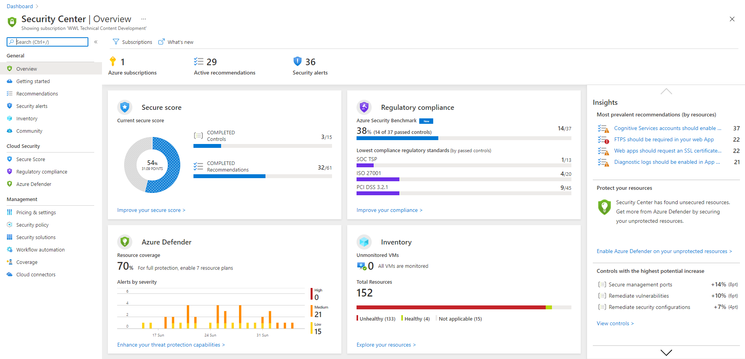
Introduction to Azure Security Center
Visibility into security posture and state of the Azure IoT Solution
Single pane of glass to manage IoT and hybrid cloud security infrastructure
Receive actionable, prioritized alerts to respond to any potential compromises of your Azure IoT solution
Notes:
This is not meant to be a deep dive on Azure Security Center – it’s to make sure that if the students have never heard of it, you have a talking prompt for it. If they all know it, you can skip this slide.

Slide 13
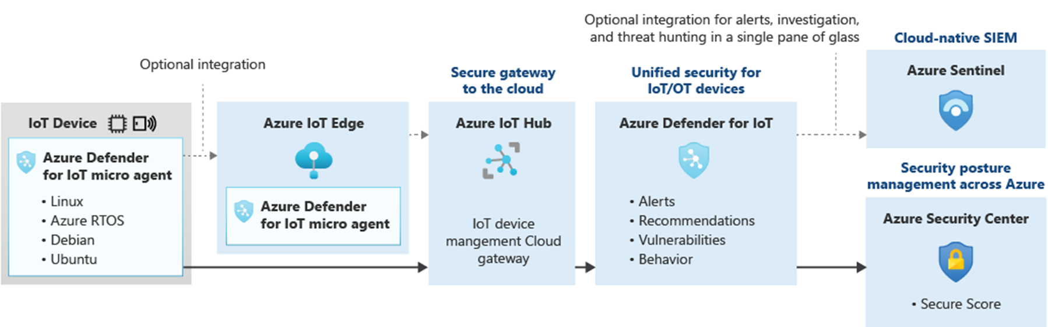
Introduction to Azure Defender for IoT
Notes:
Unified security view
Built-in security assessments
Ability to create custom assessment rules
Connectivity with existing Microsoft cybersecurity knowledge for detection of zero-day attacks, machine learning for anomaly detection, etc.

Slide 14
Azure Defender for IoT deployment options
Agentless solution – provides passive monitoring of IoT device communication on a network
Agent-based solution – provides Built-in and Enhanced modes for monitoring IoT devices. IoT Hub integrates the Agent-based solution option
Notes:
This course focuses on the Agent-based option that is integrated with IoT Hub and enabled by default.
The Agent-based option include two modes:
Built-in – Automatic, for every customer onboarding to Azure Defender for IoT
Enhanced – Requires extra deployment work (covered in next lesson)
https://docs.microsoft.com/en-us/azure/defender-for-iot/architecture

Slide 15
Configure built-in IoT Hub integration
Standard Tier IoT Hubs
Geolocation and IP address handling:
Default: IP addresses for incoming and outgoing connections from IoT Devices, IoT Edges, and IoT Hubs are collected
Log Analytics creation:
Automatic for back-end data storage to support the solution
5 GB for 31 days included for no extra charge
Customize your IoT security solution:
Can be extended beyond IoT Hub to bring in other resources
Leverages existing Security Center functionality
Notes:
https://docs.microsoft.com/en-us/azure/defender-for-iot/quickstart-onboard-iot-hub
https://docs.microsoft.com/en-us/azure/defender-for-iot/quickstart-configure-your-solution

Slide 16
Built-in alerts
The built-in assessments include a large number of alert options… they include…
Built-in alerts for IoT devices, such as:
Attempted firewall disabling
Attempted port forwarding
Attempted local sign-ins
Built-in alerts for IoT Hub, such as:
x.509 device certificate thumbprint mismatch
Expired or invalid SAS token
Attempt to change diagnostic settings without permission
Notes:
https://docs.microsoft.com/en-us/azure/defender-for-iot/concept-security-alerts

Slide 17
Customizable security alerts
“You know your IoT devices best…”
Examples - custom alerts will relate to your scenario:
How many direct method calls is too many?
How many rejected messages is too many?
Custom messages can be sent through a custom message SDK
Notes:
https://docs.microsoft.com/en-us/azure/defender-for-iot/concept-customizable-security-alerts

Slide 18
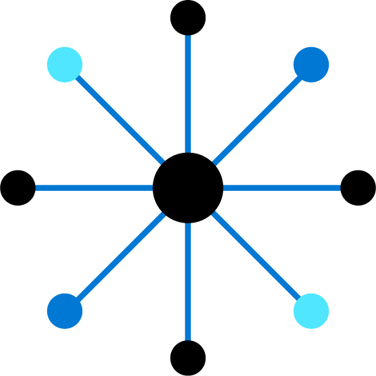
Lesson 4: Enhance Protection with Azure Defender for IoT Security agents

Slide 19
Your security agent options
Characteristics | C-based security agent | C#-based security agent
Supported Windows platforms? | No | Yes (WMI pre-requisite)
Supported Linux platforms? | Yes, x64 and x86 | Yes, x64 only
Linux prerequisites | libunwind8, libcurl3, uuid-runtime, auditd, audispd-plugins | libunwind8, libcurl3, uuid-runtime, auditd, audispd-plugins, sudo, netstat, iptables
Disk footprint | 10.5 MB | 90 MB
The above lets you figure out which agent to use in any given situation…
Notes:
“Azure Defender for IoT offers a substantial amount of monitoring from the point of view of the cloud service side without any extra configuration beyond connecting to the IoT Hub. However, there’s also an option that allows more sophisticated device-side data collection…”
The takeaway is that two options exist. There’s more details in the SkillPipe/docs; what’s here are the differences.
The SkillPipe also covers how to choose but ultimately it’s the information in the table translated into questions.
Finally, the SkillPipe and docs have information on supported Linux distributions and Windows OS versions.
Not in the SkillPipe or the course, but documented – a developer can write their own agent if they want, as long as they follow the proper message format, etc. The existing agents are open source and can be used as a reference with the documentation. This can help with unique platform configurations not supported by the Microsoft-supplied code, or potentially as an integration point for other security products.

Slide 20
Security agent deployment and testing
Deployment details depend on the device, but all have the same basic pattern…
1
Create an azureiotsecurity module definition on the device registration; The agent presents as a device module to IoT Hub and uses a module twin for configuration
2
Download the appropriate script from GitHub
3
Review it
4
Execute it
5
Run the simulated attack script to test your end-to-end solution
Notes:
https://github.com/Azure/Azure-IoT-Security/tree/master/trigger_events

Slide 21
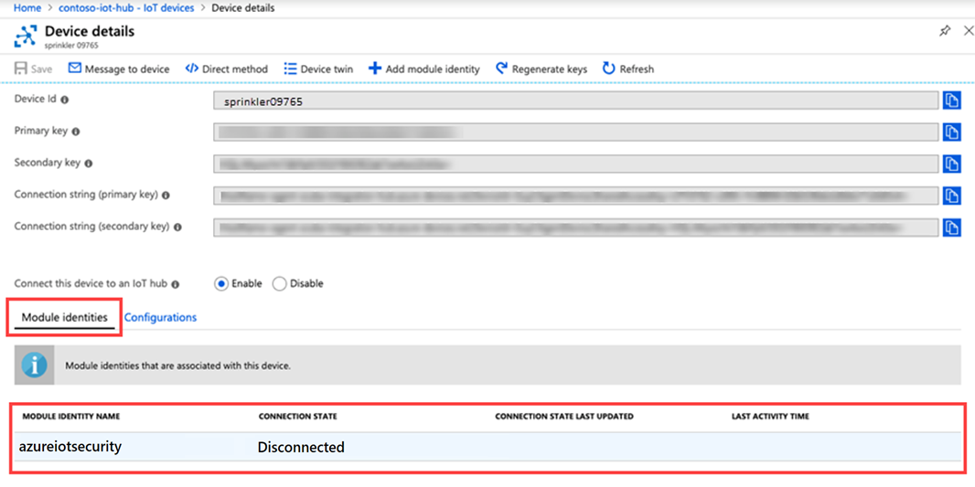
Module configuration on a non-edge device
Notes:
“Because we haven’t talked about how module identities work in the context of non-Edge devices yet, we should look at that briefly…”

Slide 22
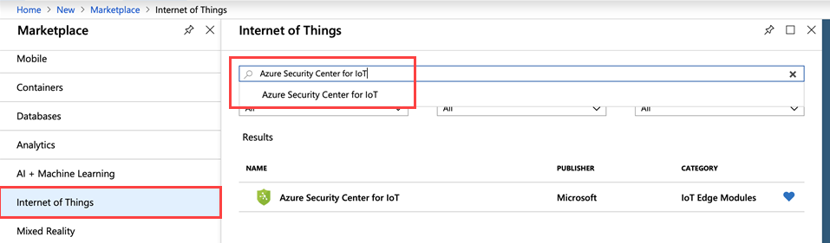
Deploy a security module on your IoT Edge device
On an IoT Edge, deployments are done through modules, as previously discussed…
In the Marketplace, there is a legacy IoT Edge Module for Azure Security Center for IoT that can be viewed
Notes:
“Although we just talked about deployment of the security agent, the unique deployment model of IoT Edge devices means the security agent deployment will be different as well…”
Note: As of April 2021, the security module in the Marketplace is named under the old branding “Azure Security Center for IoT” rather than Azure Defender for IoT. You may need to check for changes/updates in the future.

Slide 23
Security agent authentication
Authentication methods:
SecurityModule mode – authenticated using a shared key configured in the module
Device mode – authenticated using the device’s identity, shared key or certificate
Authentication method initially set during deployment
Can be changed in the appropriate configuration file after deployment
Notes:
Note that for Device mode, there are some restrictions around the certificate that’s used – Azure Defender for IoT does not support CA-signed certificates, only self-signed certificates, for Device mode at this time.

Slide 24
Built-in agent-based alerts
Agents add even more alerts to the solution… a small fraction:
Unexpected binary command line
Apparent bot behavior
Crypto-coin mining
Security configuration file unexpectedly accessed (e.g. .htaccess)
Local user added to a new group
Notes:
“At this point you have an agent working and communicating with Azure Defender for IoT. This adds more data collection capabilities and a large number of new alerts…”

Slide 25
Recommendations from Azure Defender for IoT
Device configuration recommendations, such as locking down an open firewall
Device operational recommendations, such as correcting conflicting settings in the security module twin configuration
IoT Hub configuration recommendations, such as correcting duplicate credentials across devices
Notes:
“Once you have configured the agents, what kinds of recommendations can you expect to see from Azure Security Center for IoT?...”

Slide 26
Baseline
Baseline – allow running custom configuration checks on a device and comparing the result to a desired result
Stored in an XML file on the device being evaluated
Module twin gives location of the file and a SHA256 hash of the file
File format documentation is mostly by examples in GitHub
Notes:
“Another feature of Azure Defender for IoT is something we refer to as baselines...”
[later while still on this slide, after explaining the bullet points]
“For example, your may find baselines useful for implementing recommendations from Azure Defender for IoT, especially device configuration recommendations.”

Slide 27
Lesson 5: Module Labs

Slide 28
Module 10 Labs
Lab 18: Azure Defender for IoT:
You will enable Azure Defender for IoT Hub
You will manually create a security module twin
You will add a security agent for C# that you will deploy on your simulated device

Slide 29
Lesson 6: Module 10 review questions

Slide 30
Module review: Question 10.1
You are developing an IoT solution for your company. You have IoT devices and IoT Edge devices configured and running in your solution. You recently implemented monitoring tools and made improvements to your solution as a result. You are confident that you’ve implemented appropriate security measures throughout your solution. When a coworker asks you if you are using Azure Security Center you become concerned. You have started an investigation of Azure security tools
What is Azure Security Center intended to help with? (choose one best answer)
Answer A:
Securing your devices and securing device communications as they transmit over the wire
Answer B:
Securing your network and your services
Answer C:
Developing your threat models
Answer D:
Developing your solution architecture
Notes:
Correct Answer: B
Explanation: In the student workbook/skillpipe content, topic What is Azure Security Center includes the following:
Azure Security Center provides you the tools needed to harden your network, secure your services and make sure you're on top of your security posture.
Azure Security Center addresses the three most urgent security challenges:
Rapidly changing workloads – It’s both a strength and a challenge of the cloud. On the one hand, end users are empowered to do more. On the other, how do you make sure that the ever-changing services people are using and creating are up to your security standards and follow security best practices?
Increasingly sophisticated attacks - Wherever you run your workloads, the attacks keep getting more sophisticated. You have to secure your public cloud workloads, which are, in effect, an Internet facing workload that can leave you even more vulnerable if you don't follow security best practices.
Security skills are in short supply - The number of security alerts and alerting systems far outnumbers the number of administrators with the necessary background and experience to make sure your environments are protected. Staying up-to-date with the latest attacks is a constant challenge, making it impossible to stay in place while the world of security is an ever-changing front.

Slide 31
Module review: Question 10.2
You are developing an IoT solution for your company. You have IoT devices and IoT Edge devices configured and running in your solution. You have implemented monitoring and logging tools and are looking to do the same for security. You have started an investigation of Azure security tools
Which of the following are components of Azure Defender for IoT? (choose all correct answers)
Answer A:
IoT Hub integration
Answer B:
Device agents (optional)
Answer C:
Send security message SDK
Answer D:
DPS enrollment pipeline
Notes:
Correct Answer: A, B, C
Explanation: In the student workbook/skillpipe content, topic Introduction to Azure Security Center for IoT includes the following:
Azure Security Center for IoT enables you to unify security management and enable end-to-end threat detection and analysis across hybrid cloud workloads and your Azure IoT solution.
Azure Security Center for IoT is composed of the following components:
- IoT Hub integration
- Device agents (optional)
- Send security message SDK
- Analytics pipeline
Secure your entire IoT solution from IoT devices to Azure cloud.
Choose from our seamless agentless solution or take advantage of agent-based comprehensive security, Azure Security Center for IoT provides threat prevention and analysis for every device, IoT Edge and IoT Hub, across your IoT assets.

Slide 32
Module review: Question 10.3
You are developing an IoT solution for your company. You have IoT devices and IoT Edge devices configured and running in your solution. You have implemented monitoring and logging tools and are looking to do the same for security. You want to deploy Azure Defender for IoT
Which of the following describe differences between the Built-in and Enhanced options of an agent-based implementation? (choose all correct answers)
Answer A:
Real-time monitoring is only available with the Enhanced option
Answer B:
Built-in mode does not require agent installation on any devices and uses advanced analytics on logged activities
Answer C:
Built-in mode uses device agents on your devices to aggregate and analyze raw security events from your devices
Answer D:
Enhanced mode uses device agents on your devices to aggregate and analyze raw security events from your devices
Notes:
Correct Answer: B, D
Explanation: In the student workbook/skillpipe content, topic Azure Defender for IoT Deployment Options includes the following:
Azure Defender for IoT works in one of two feature workflows: Agentless and Agent-based. The Agent-based implementation includes two options:
Built-in
In Built-in mode, Azure Defender for IoT is enabled when you elect to turn on the Security option in your IoT Hub. Offering real-time monitoring, recommendations and alerts, Built-in mode offers single-step device visibility and unmatched security. Build-in mode does not require agent installation on any devices and uses advanced analytics on logged activities to analyze and protect your field device.
Enhanced
In Enhanced mode, after turning on the Security option in your IoT Hub and installing Azure Defender for IoT device agents on your devices, the agents collect, aggregate and analyze raw security events from your devices. Raw security events can include IP connections, process creation, user logins, and other security-relevant information. Azure Defender for IoT device agents also handle event aggregation to help avoid high network throughput. The agents are highly customizable, allowing you to use them for specific tasks, such as sending only important information at the fastest SLA, or for aggregating extensive security information and context into larger segments, avoiding higher service costs.

Slide 33
Module review: Question 10.4
You are developing an IoT solution for your company. You have IoT devices and IoT Edge devices configured and running in your solution. You have implemented monitoring and logging tools and are looking to do the same for security. You have deployed Azure Defender for IoT using the Agent-based option and you have elected to use the Enhanced mode. You are now ready to implement security agents
Which of the following statements describe how security agents are used? (choose all correct answers)
Answer A:
Security agents can be used to monitor remote connections
Answer B:
Security agents handle raw event collection from the device operating system
Answer C:
Security agents are part of the IoT Edge device attestation mechanism for DPS
Answer D:
Security agents can be used on devices with fewer available resources
Notes:
Correct Answer: A, B, D
Explanation: In the student workbook/skillpipe content, topic Introduction to Security Agents includes the following:
Azure Security Center for IoT security agents offer enhanced security capabilities, such as monitoring remote connections, active applications, login events, and operating system configuration best practices. Security agents handle raw event collection from the device operating system, event aggregation to reduce cost, and configuration through a device module twin. Security messages are sent through your IoT Hub, into Azure Security Center for IoT analytics services.
A reference architecture for Linux and Windows security agents is provided with support for both C# and C.
Security agents offer the same set of features for C and C#, and support for similar configuration options is provided for both language options.
The C-based security agent has a lower memory footprint, and is the ideal choice for devices with fewer available resources.

